Slide 1
BCB330 Undergraduate Project Cathy Cha

Slide 2
What is Bioinformatics?
Undergraduate program at Uoft
Computer Science
Software Design, Software tools, Systems programming, Computational theory, Data structures, Databases, Computational statistics, and Algorithm design and analysis
Life Science
Cell molecular biology, Chemistry, Biochemistry, Genetics
Research
Work-study, 3rd year research program, 4th year research program
A lot of bioinformatic software currently currently out there works on data visualization and data analysis
Notes:
I’m currently in my 4th year of undergrad in the bioinformatics program. I’ll start off with a brief introduction of my program just in case anyone was curious about what a undergraduate in bioinformatics actually learns. The bioinformatics and computational biology specialist at uoft is actually a joint program hosted by the computer science and formerly the biochemistry department and from this year on the cell and systems biology department.
Our computer science background includes learning languages such as java, C, SQL, python, R
And theories like algorithms, object oriented programming, and other computational theory such as data structures.
Our background in life science includes the basic first and second year life science courses, and additionally a specialization in biochemistry and genetics.

Slide 3
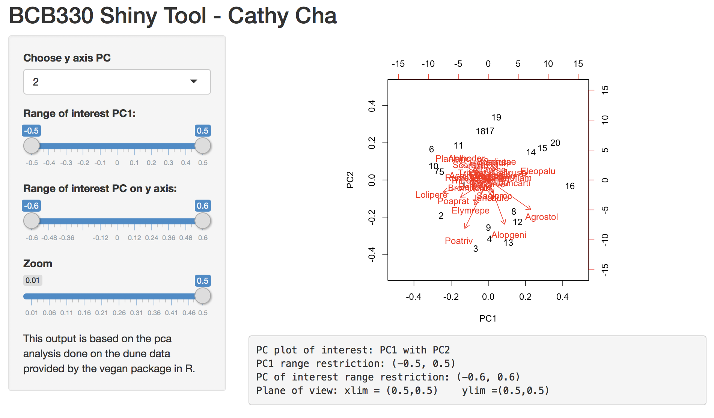
My Project
Shiny application for ecology data analysis
To be used during exploratory data analysis
Notes:
So using this knowledge and the ecology based research in this lab. My project was based on creating an interactive application that would speed up the exploratory data analysis process by allowing the user to visually manipulate multivariate analysis results in real-time.

Slide 4
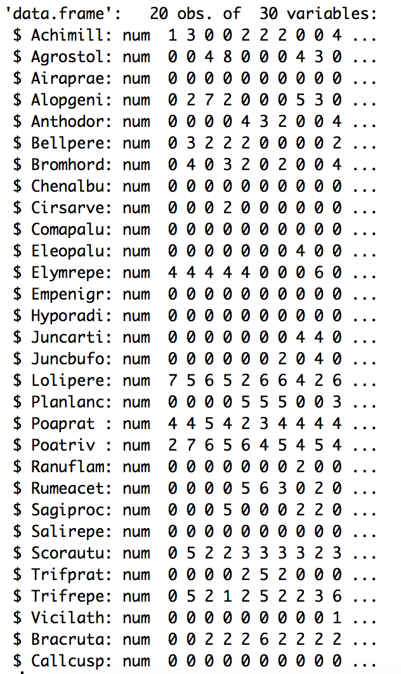
Data
Swallowtail butterfly data
SNP’s
data provided was not user-friendly
Example data from vegan library
Dune Meadows Observation
Species – 30 species
Observation – observed on 20 different sites
Variables – moisture, management, thickness of soil, use, and manure
Notes:
The original plan was to use raw data from a paper dealing with the hybrid dynamics of swallowtail butterflies. BUT, the data provided by that paper was actually very user-unfriendly so we used the example data from the Community ecology package, vegan in R.
This data is the observation of species in specific sites in the Dune Dutch meadows in the Netherlands
The actual data itself is given as a 20 by 30 dataframe with species as columns and sites they were observed in as rows.
For site has additional variables such as moisture management, thickness of soil, use, and manure

Slide 5
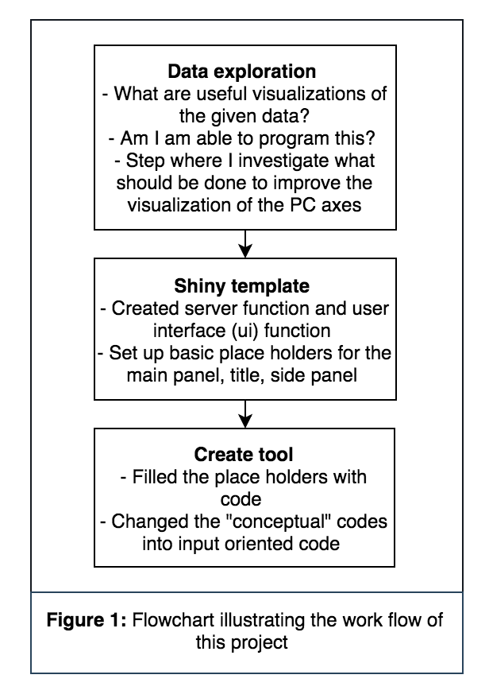
Work Flow
Notes:
So the workflow that I followed through for this project is first:
Data exploration
So trying to figure our what visual manipulations are useful
And generally how I would go about coding the manipulations
Then the next step I took was to define a Shiny Template, based on the Shiny tutorial we had a few months ago.
And my last step was doing the actual coding portion.
And I did this by first trying to get the desired outcome based on small examples and then implementing them into Shiny as input oriented code, which I will discuss more about in a few slides

Slide 6
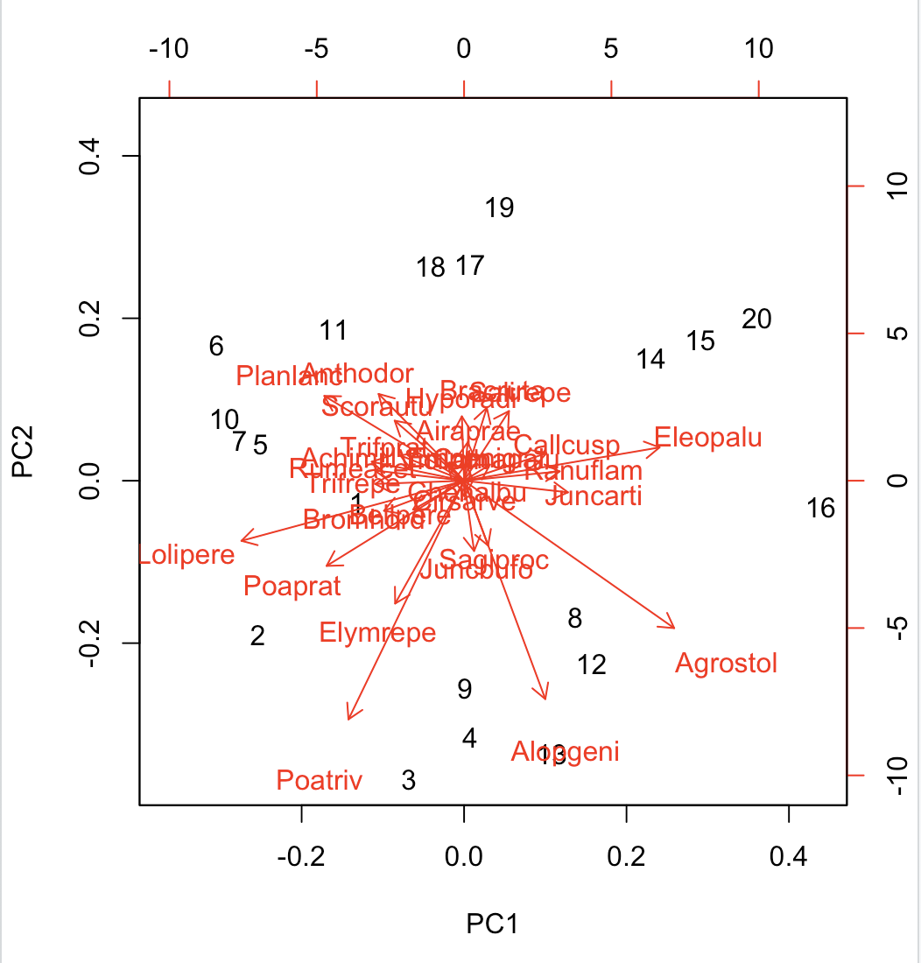
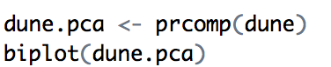
Data Exploration
Notes:
When the data set is run through prcomp() function in R to get the principle component analysis and then plotted using biplot()
This is the resulting plot in Rstudio
As you can see its really hard to read the species names when they’re clustered in the middle

Slide 7
Data Exploration - Functions
Interchangeability of the PC’s
By default, PC1 with PC2
Can also do PC1 with PC3
Restricting the range of values of the PC’s
Zoom to the (0,0) coordinates of the plot
Notes:
So from looking at the output of biplot(), there were a couple of visual manipulations that would be deemed useful for analysis of this data
Interchangeability of the PC’s
Range restriction
And Zooming up to the (0,0) coordinates – where they would most clustered

Slide 8
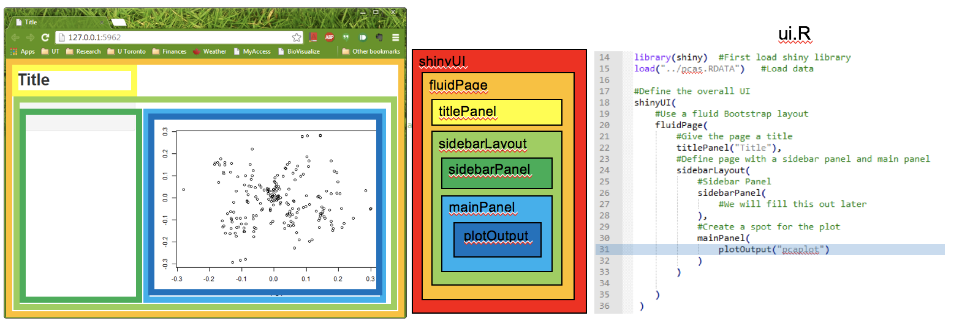
Shiny Template
Notes:
So I went from the basic template provided in the Shiny tutorial we did and ….

Slide 9
Final Product
Ability to choose the PC of interest to compare against PC1
Main plot
Restrict the range of the PC values being plotted
Short summary of the input values of the resulting plot
Zoom up to the (0,0) coordinates of the plot’s viewing frame
Notes:
And this is my final product
*show again in RStudio*
Includes a drop down bar,
Slider toggles
And short description of what is being manipulated

Slide 10
Before and After
Notes:
I will do a short before and after for each function and how this has made visual manipulations a lot easier

Slide 11
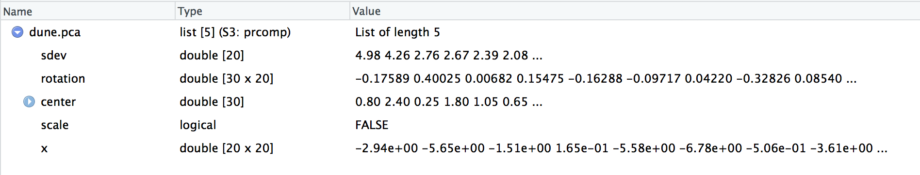
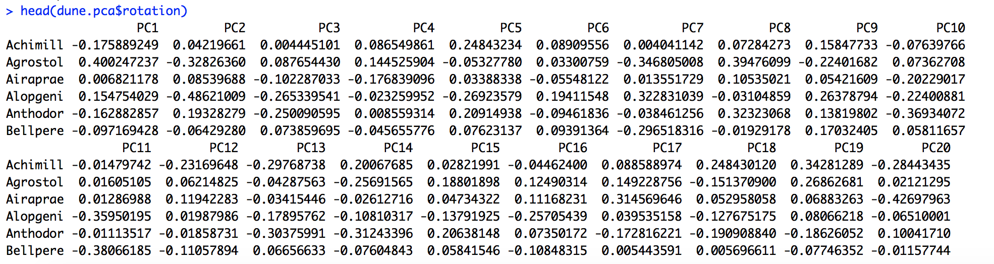
Data Exploration – prcomp() output
Notes:
To breifly explain what the prcomp() function outputs for principal component analysis
The prcomp() function Ireturns a list of 5 objects, but what am using for this tool I’m only interested in the principal component values which are stored in the rotation object - which includes the PC’s of the data set.
Rotation is a dataframe in R that contains PC’s as the columns and the species as rows
Running a query to restrict the values of the PC’s returns a restricted visualization of the plot.

Slide 12
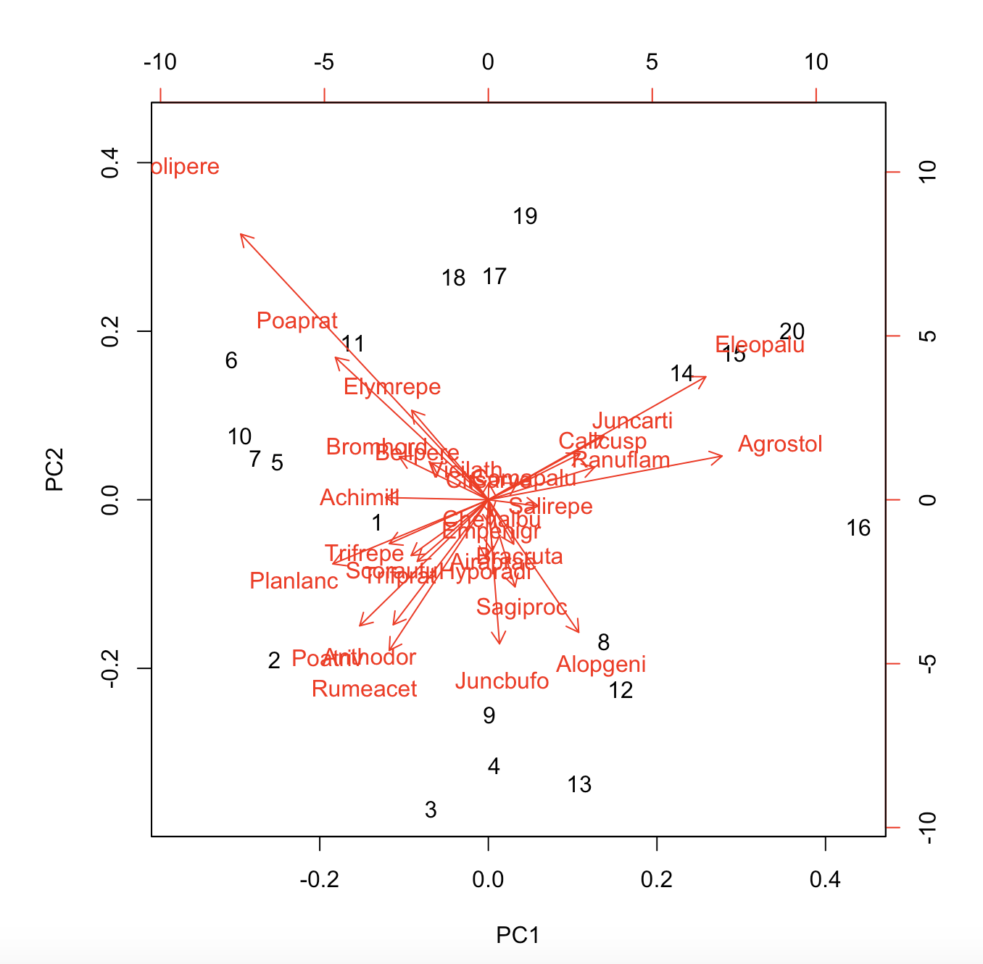
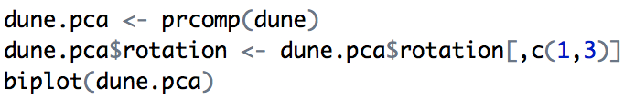
Before – PC Interchangeability
Notes:
Before, if you wanted to plot pc1 with pc3
You need to collect the PC1 and PC3 column in rotation data frame
And then plot it using biplot

Slide 13
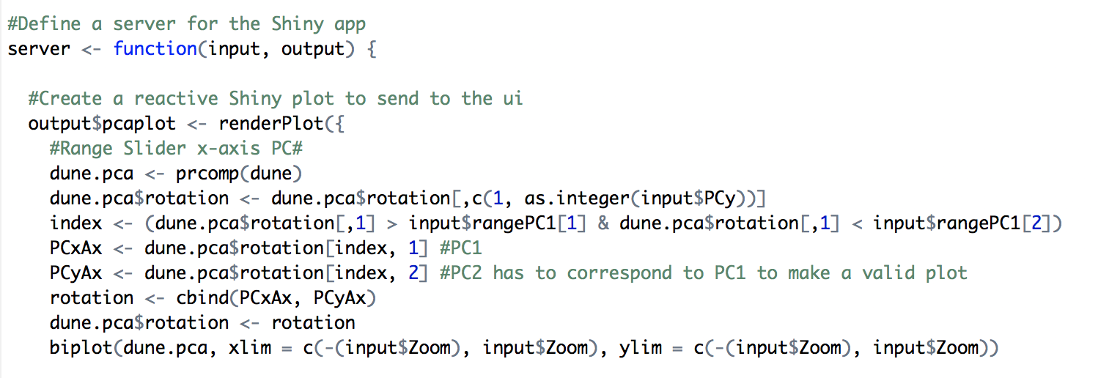
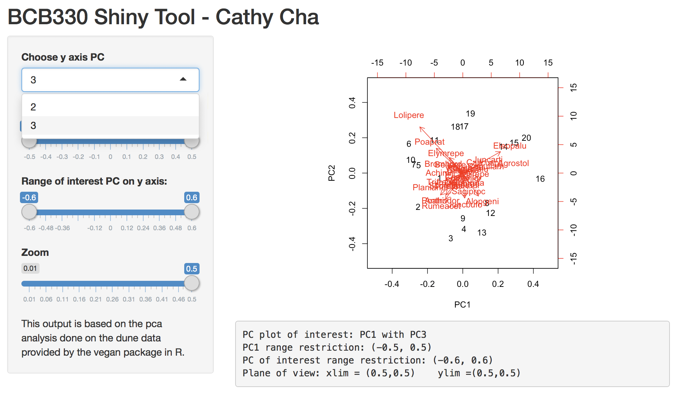
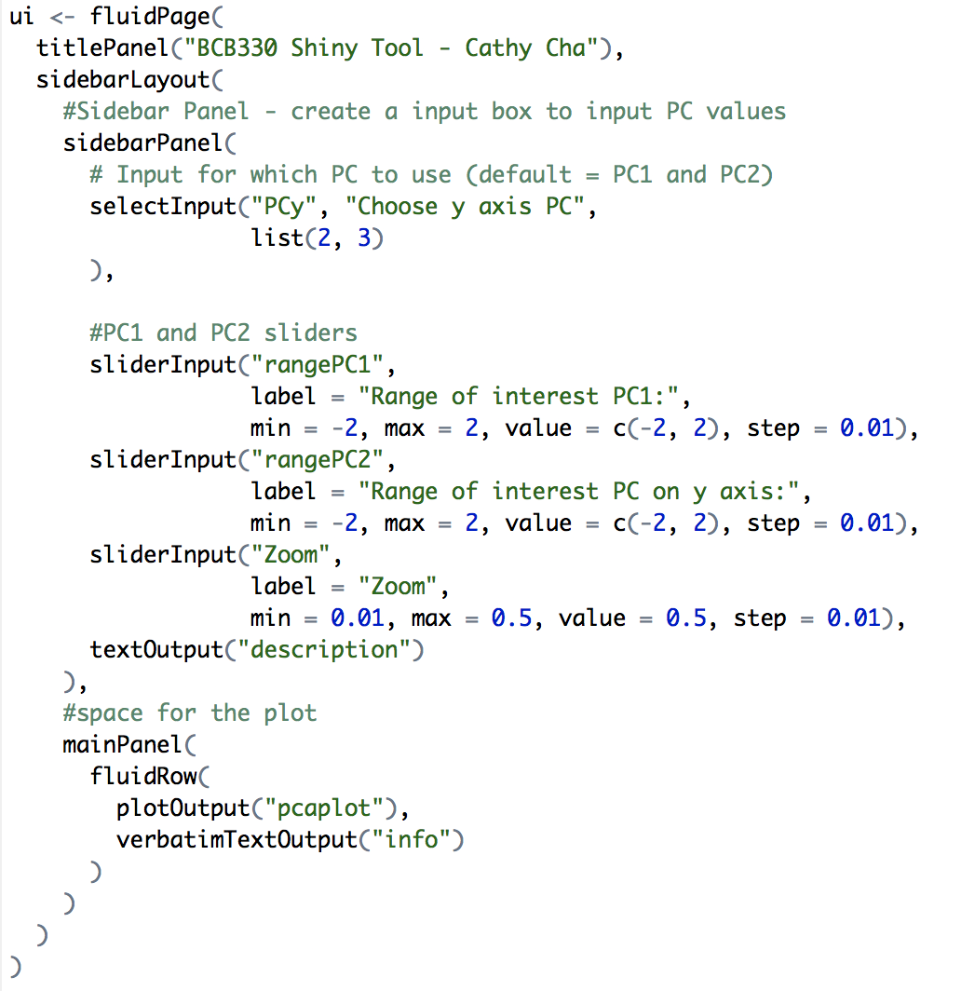
After

Slide 14
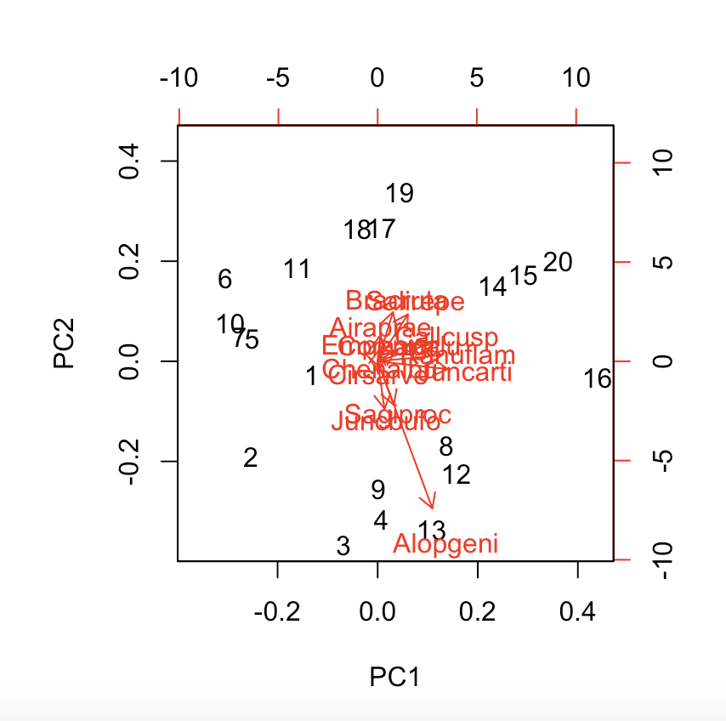
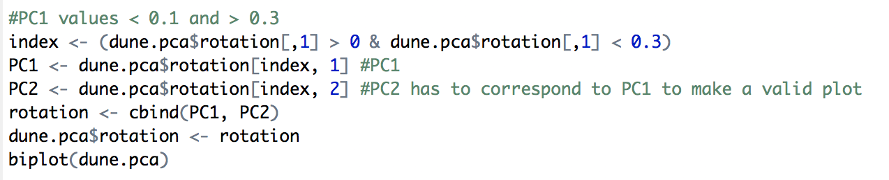
Before – PC range restriction
Notes:
PC range restriction
You would have to once again get the PC column of interest from the rotation dataframe then run a simply query to restrict the values
This would be time consuming, because you would have to manually change and write new lines of code for every restriction your interested in visualizing

Slide 15
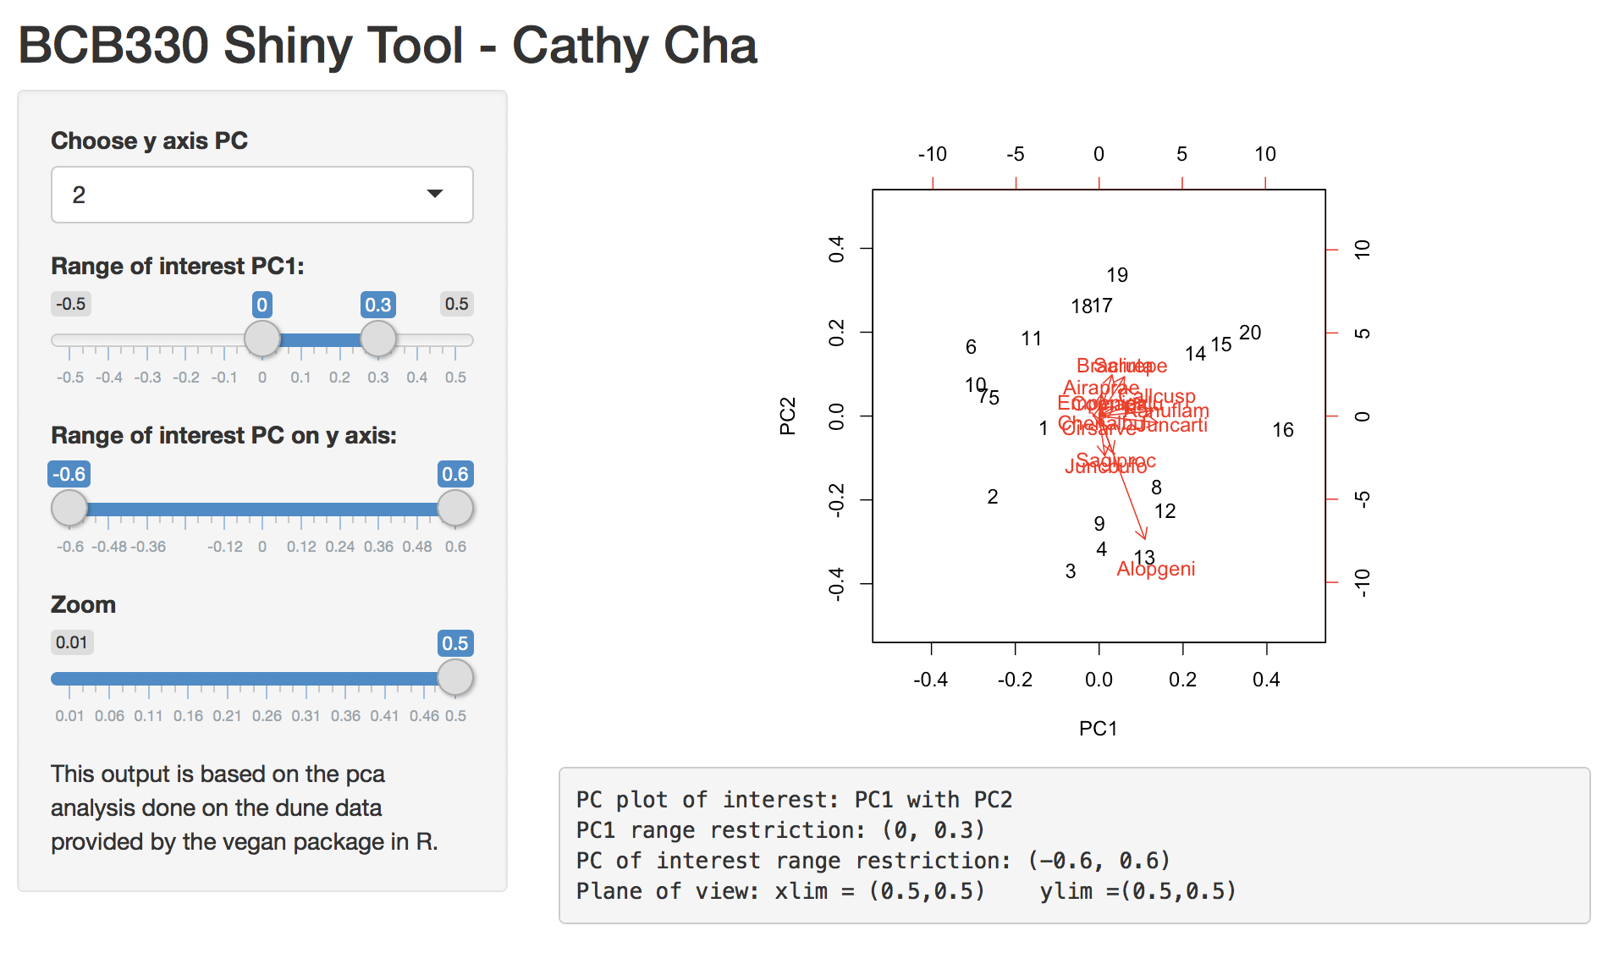
After

Slide 16
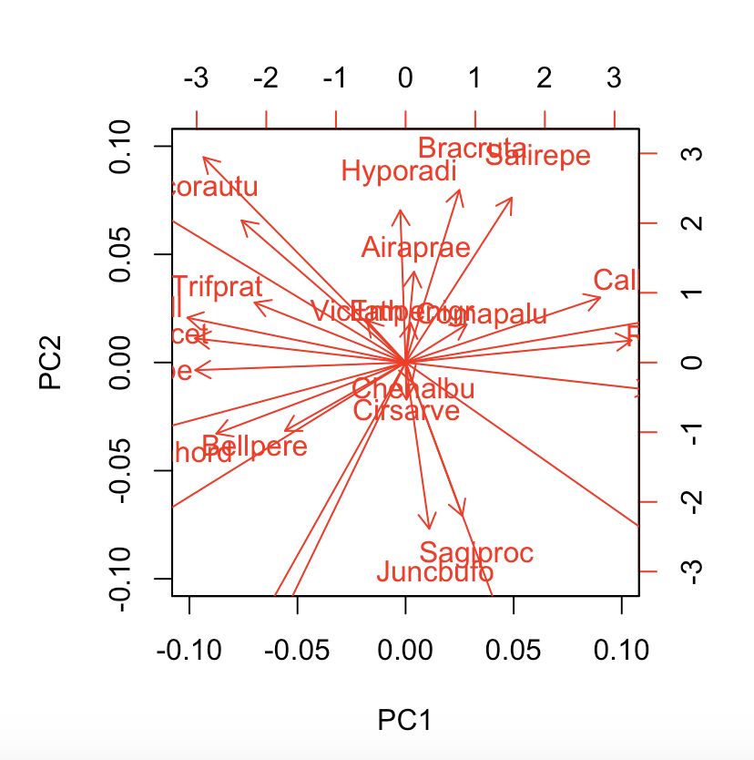

Before – Zoom
Notes:
Zoom function
Using the xlim and ylim argument that are provided by the biplot function, you can restrict the viewing frame of the plot
But once again it is tedious work, to have to plot the graph everytime you want to change the viewing frame

Slide 17
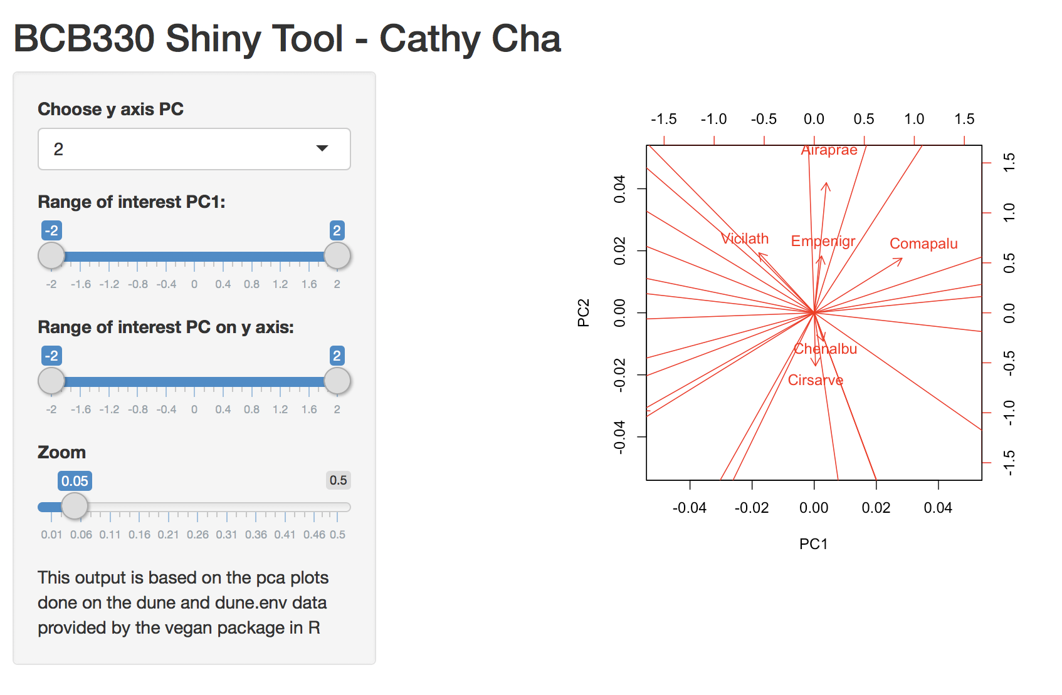
After

Slide 18
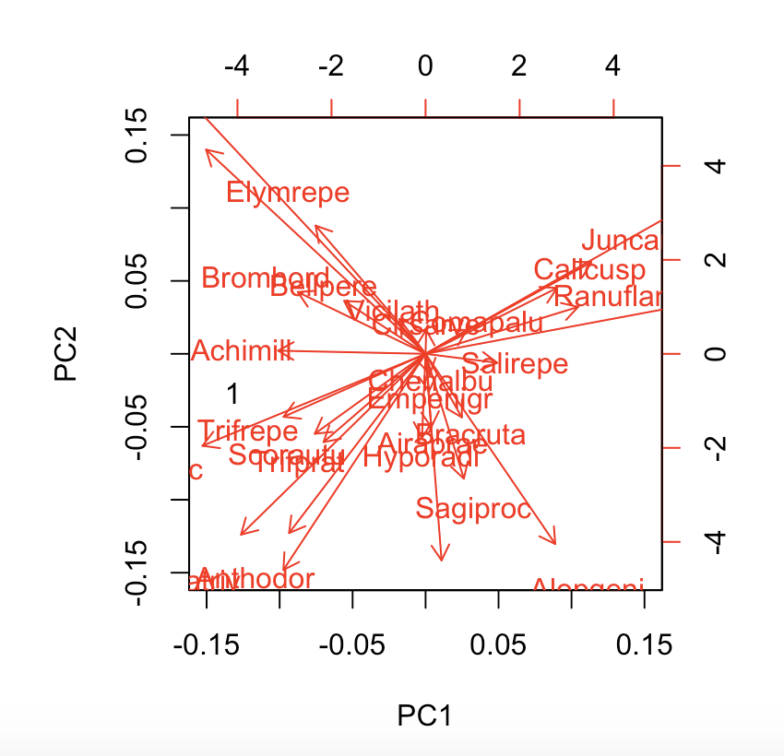
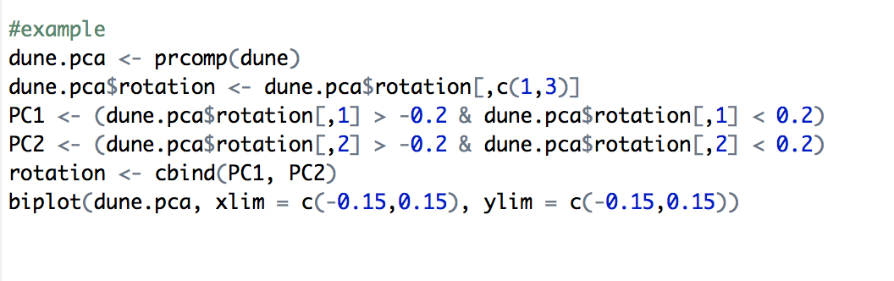
Before – all together
Notes:
Lastly,
- To incorporate all the functions together it would require a few lines of code just for one specific visualization of the plot

Slide 19
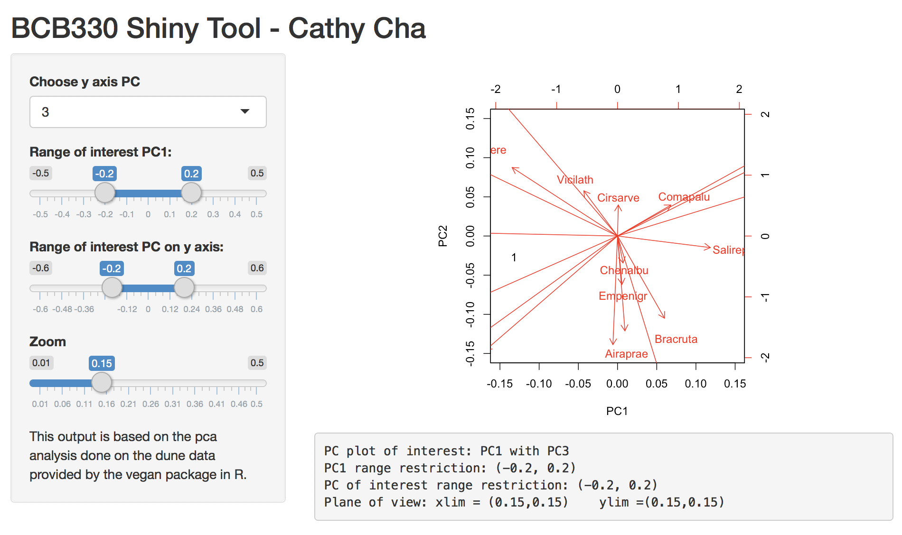
After
Notes:
And I think that is the biggest advantage of this tool, to be able to manipulate all the functions simultaneously with a slide of a toggle

Slide 20
Usefulness of the Shiny tool
Real time visualization of data
Saves significant amount of time during EDA
User friendly
Don’t need extensive computational knowledge to use this tool
Better resolution of data plots than the traditional methods (e.g., biplot in R)
Notes:
So why is this useful?
And this was an unexpected result, but the plot function actually produces a plot with better resolution than when the plot is shown in RStudio

Slide 21
Next Steps
Add “input dataset” function so that this tool can be used with any data set of interest
Currently can be only used with dune dataset (limitation to this tool)
Notes:
My current tool is currently structured in a way that it can only be used with the dune dataset.
As a next step to further develop this tool, I think it would be useful to incorporate a "input dataset" function so that the user can use this tool with any data set under investigation

Slide 22
Thank You

